Slide 1





SPRING & SPRING BOOT
LECTURE - 3

Slide 2

Today’s Agenda
Setting Up The Development Environment
Introduction To Spring Core
Types Of Classes In Java
What Is Dependency Injection ?

Slide 3
Setting Up The Development Env
To work with Spring 6.x.x we need to have:
JDK 17 or greater
Any Java IDE : Eclipse, IntelliJIdea, STS( Spring Tool Suite )
We will be using STS in this course.

Slide 4
About Spring Tool Suite
STS is a Java IDE tailored for developing Spring-based applications.
STS is free, open-source, and powered by VMware.
It is easier, faster, convenient and most importantly it is based upon the popular Java IDE called Eclipse.
Its latest version is 4.23.0 .

Slide 5
Downloading & Setting Up STS
Go to the website (https://spring.io/tools) and scroll to the Eclipse section in order to download.
Choose the corresponding file according to your OS.

Slide 6
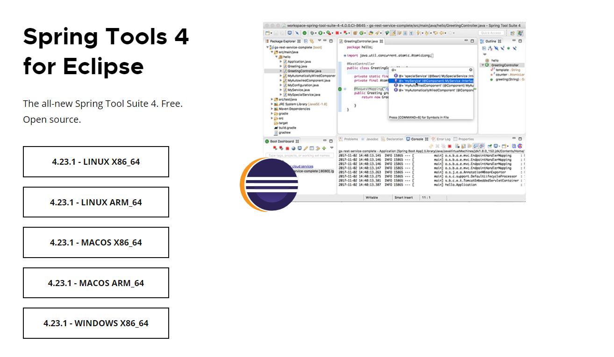
Downloading & Setting Up STS

Slide 7
Downloading & Setting Up STS
After clicking on the button a Jar file will be downloaded to your system.
Now create a folder and move this Jar file to that folder.
Then double-click on that Jar file.
A pop-up window will appear as shown on next slide

Slide 8
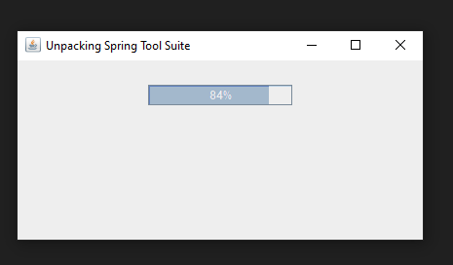
Downloading & Setting Up STS

Slide 9
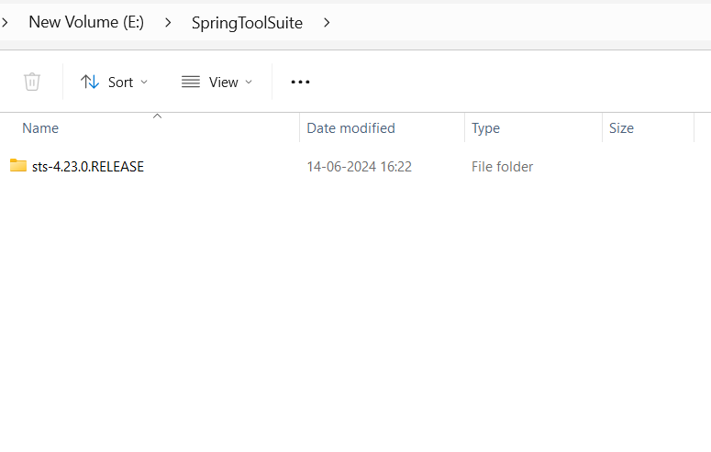
Downloading & Setting Up STS
After successfully Unpacking a new folder will be created as shown in the below image:
Now open this folder

Slide 10
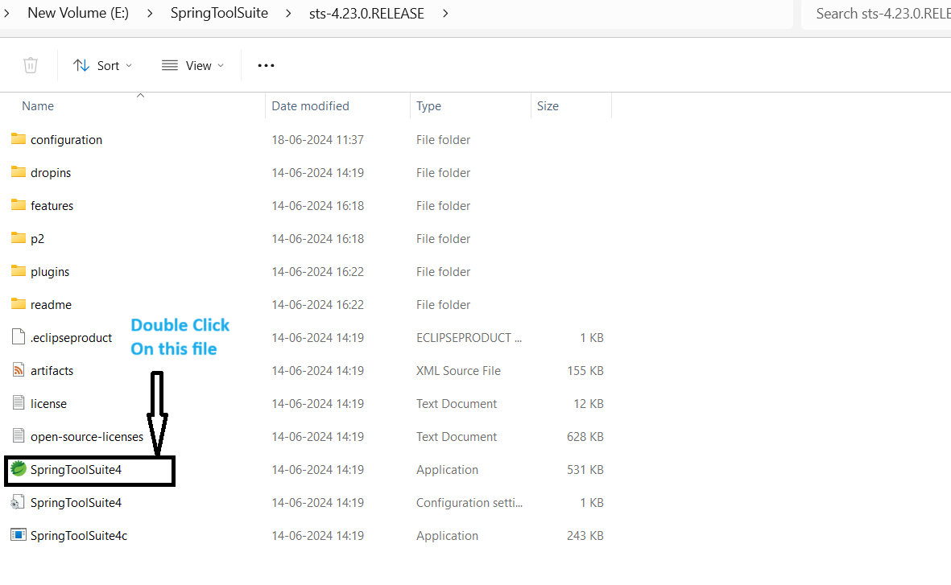
Downloading & Setting Up STS
In this folder , double click on the SpringToolSuite4 Application file to launch STS

Slide 11
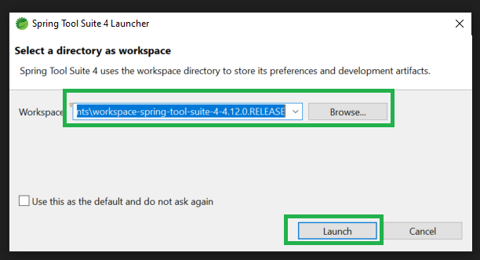
Downloading & Setting Up STS
Now select any of your directory as workspace by clicking on the Browse button and then click on the Launch button.
That's all , now STS has been set up on your machine.

Slide 12
Introduction To Spring Core
Spring Core is the most important module of the Spring framework.
Its good understanding is very essential before we can learn any other spring module like Spring Data, Spring JDBC, Spring MVC

Slide 13
Introduction To Spring Core
The Spring Core module provides many features like:
DI ( Dependency Injection )
IoC ( Inversion Of Control )
Bean LifeCycle
BeanScope
Autowiring and many more
But we will have to start with DI before we can understand any of them .

Slide 14
Understanding Dependency Injection
To understand DI , let us understand the types of classes any Java Project can contain.
As per industry standards any Java Project will have 3 types of classes:
POJO
Bean
Component

Slide 15
What Is A POJO ?
POJO stands for Plain Old Java Object.
It is an ordinary Java class, not bound by any special restriction.
Specifically a POJO
Can’t extend any class
Can’t implement any interface
Can’t have any outside annotations

Slide 16
Test Your Understanding
Is this a POJO ?
Yes , it is a POJO
public class Student {
}

Slide 17
Test Your Understanding
Is this a POJO ?
Yes , it is a POJO
public class Student { private int roll; private String name; private double per; }

Slide 18
Test Your Understanding
Is this a POJO ?
Yes , it is a POJO
public class Student { private int roll; public String name; double per; }

Slide 19
Test Your Understanding
Yes , it is a POJO
Is this a POJO ?
public class Student { private int roll; public String name; double per; public void set(){ roll=10; name="Ravi"; per=56.7; } void show(){ System.out.println(roll+","+name+","+per); } }

Slide 20
Test Your Understanding
Is this a POJO ?
No.
Because it is extending the Person class
Assume Person is a class defined somewhere in our code
public class Student extends Person { private int roll; public String name; double per; }

Slide 21
Test Your Understanding
Is this a POJO ?
No.
Because it is implementing the Human interface
Assume Human is an interface defined somewhere in our code
public class Student implements Human{ private int roll; public String name; double per; }

Slide 22
What Is A Java Bean ?
A Java Bean is a POJO but with few restrictions:
Should have a public no-argument constructor.
Should have private attributes only.
Should have public getters and setters for accessing and setting the private attributes.
Should implement the Serializable interface.
By implementing Serializable interface an object can be saved in the secondary memory or passed over a network.

Slide 23
Test Your Understanding
Is this a Java Bean ?
No.
Because all it’s attributes/data members are not private.
public class Student { private int roll; public String name; double per; }

Slide 24
Test Your Understanding
Is this a Java Bean?
No.
Because it is not having any of the setter and getter methods
public class Student { private int roll; private String name; private double per; }

Slide 25
Test Your Understanding
Is this a Java Bean?
No.
Because it is not having a non-parametrized constructor
public class Student { private int roll; private String name; public Student(int roll, String name) { this.roll = roll; this.name = name; } public int getRoll() { return roll; } public void setRoll(int roll) { this.roll = roll; } public String getName() { return name; } public void setName(String name) { this.name = name; } }

Slide 26
Test Your Understanding
Is this a Java Bean?
Yes , it is a Java Bean
public class Student { private int roll; private String name; public int getRoll() { return roll; } public void setRoll(int roll) { this.roll = roll; } public String getName() { return name; } public void setName(String name) { this.name = name; } }

Slide 27
Test Your Understanding
Question
Is every Bean a POJO or every POJO is a Bean ?
Answer
Every Bean is a POJO , but not every POJO can be a Bean .

Slide 28
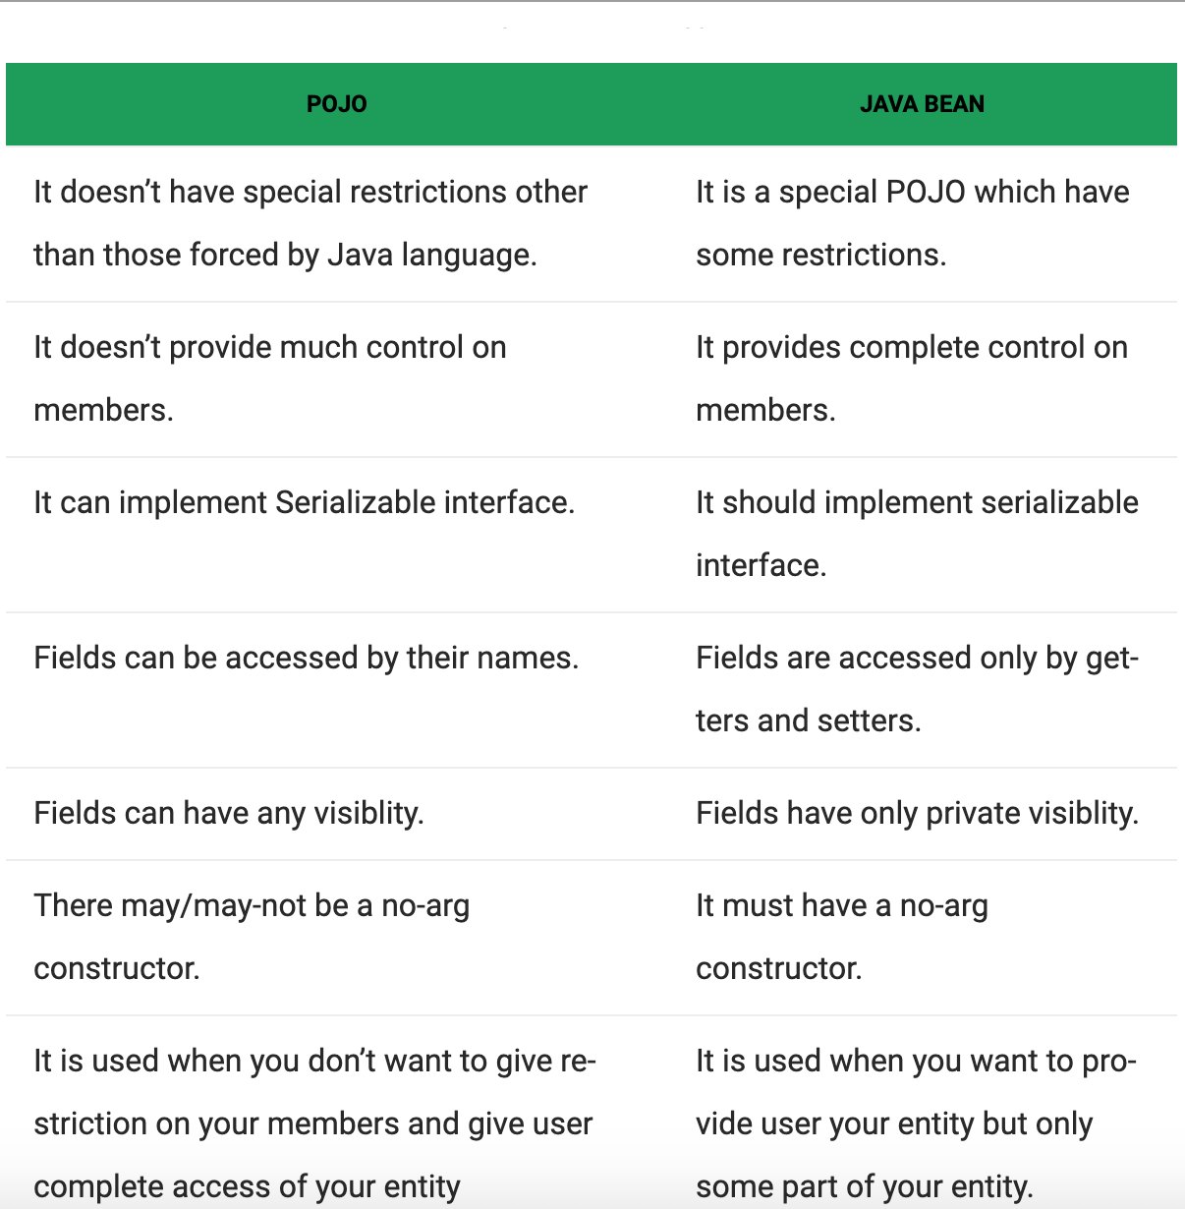
Pojo V/s Java Bean

Slide 29
What Is A Component Class?
Any class which contains business logic is called as Component class.
For example :
An Account class containing methods for withdrawing , depositing or transferring money.
A Message class for sending SMS or Email.
A DAO class containing methods for inserting, updating or deleting records

Slide 30
Dependent Or Independent ?
After understanding types of classes in a Java application let us answer a very simple but important question .
Question ?
Are these classes independent or dependent on each other ?
OR
Will one class require the services of another class ?

Slide 31
Example
class Car{ //some members }
class Engine{ //some members }
class Programmer{ //some members }
class Laptop{ //some members }
Yes , definitely because a Car uses an Engine for driving and a Programmer uses a Laptop for coding.
Do you think that :
This feature in programming is called DEPENDENCY
Car needs Engine
OR
Programmer needs Laptop

Slide 32
What Is Dependency ?
If a class requires the services of another class for implementing some task then we say it is dependent on that class.
Some More Examples
Student depends on College for degree and placements.
During online shopping a Customer depends on a Credit/Debit Card for completing the payment.
An e-commerce company like Amazon or Flipkart depends on a courier company like Blue Dart or DTDC for delivering the products.

Slide 33
How To Manage Dependency ?
To manage the dependency we must be able to connect/link one class to another.
In how many ways can two classes be connected/linked ?
In Java we have 2 ways to do this:
Using Inheritance ( also called as IS A relationship )
Using Composition ( also called as HAS A relationship )

Slide 34
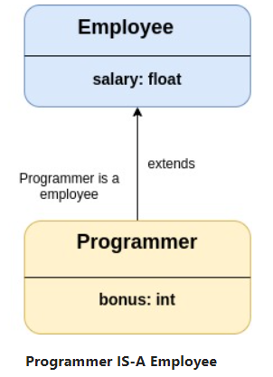
Inheritance ( IS-A Relationship )

Slide 35
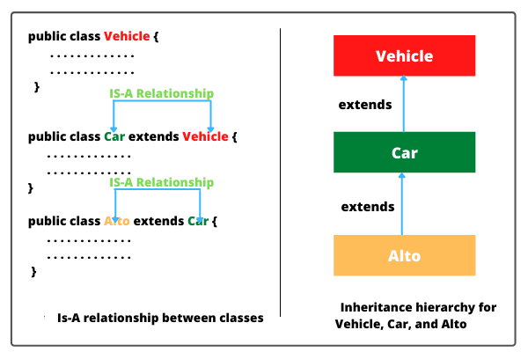
Inheritance ( IS-A Relationship )

Slide 36
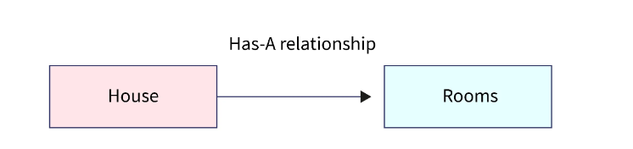
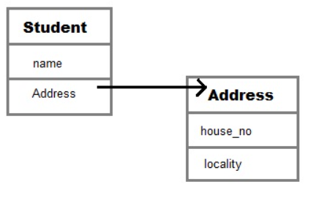
Composition (HAS-A Relationship )

Slide 37
Dependency Using Inheritance
package in.scalive.beans;
public class LapTop {
public boolean start() {
//some logic
System.out.println("Laptop started...");
return true;
}
}

Slide 38
Dependency Using Inheritance
package in.scalive.beans;
public class Programmer extends LapTop {
public void writeCode() {
boolean res=super.start();
if(res) {
System.out.println("Coding started...");
}else {
System.out.println("Could not write the code");
}
}
}

Slide 39
Dependency Using Inheritance
package in.scalive.app;
import in.scalive.beans.Programmer;
public class UseProgrammer {
public static void main(String[] args) {
Programmer p=new Programmer();
p.writeCode();
}
}
OUTPUT
======
Laptop started...
Coding started...

Slide 40
Problems With Inheritance
Although the code works but it as 2 problems:
Inheritance always implies IS A relationship and it is not correct to say that “Programmer IS A Laptop”.
In future if the Programmer class wants to inherit some other class then it is not possible to do that.

Slide 41
Dependency Using Composition
package in.scalive.beans;
public class LapTop {
public boolean start() {
//some logic
System.out.println("Laptop started...");
return true;
}
}

Slide 42
Dependency Using Composition
package in.scalive.beans;
public class Programmer {
private LapTop lt;
public void writeCode() {
lt=new LapTop();
boolean res=lt.start();
if(res) {
System.out.println("Coding started...");
}else {
System.out.println("Could not write the code");
}
}
}

Slide 43
Dependency Using Composition
package in.scalive.app;
import in.scalive.beans.Programmer;
public class UseProgrammer {
public static void main(String[] args) {
Programmer p=new Programmer();
p.writeCode();
}
}
OUTPUT
======
Laptop started...
Coding started...

Slide 44
Problems With Composition
Although the code works but this approach also has 2 problems:
It becomes programmer’s responsibility to create object of both the classes, specially the LapTop class.
Most important problem is that both the classes are tightly coupled.

Slide 45
What Is Tight Coupling ?
Tight coupling is a situation where the components (objects) of a program are highly dependent on one another, creating strong interconnections and interdependencies.
class RAM
{
//...
}
class FiftyMpCamera
{
//...
}
class Battery
{
//...
}
class Mobile
{
Processor processor = new Processor();
RAM ram = new RAM();
FiftyMpCamera camera = new FiftyMpCamera();
Battery battery = new Battery();
}
class Processor
{
//....
}

Slide 46
Problem With Tight Coupling
In a tightly coupled system, changes or modifications are very difficult.
In simple words any change in one requires a change in the other, thereby making it challenging to modify or maintain code.

Slide 47
Problem With Tight Coupling
To understand this , try answering the following questions:
In the Programmer-LapTop example what will happen if the LapTop class is modified and we provide a parametrized constructor in it ?
What if we have another object of Programmer class and this object wants to use Desktop rather than LapTop ?
Answer to both the questions is that our code in Programmer class will start giving error unless we change it also.

Slide 48
Solution: Dependency Injection
Dependency Injection (DI) is a design pattern which allows the creation of dependent objects outside of a class and supply those objects to a class through different ways.
When using dependency injection, objects are given their dependencies at run time rather than compile time.

Slide 49
Benefit ?
Code becomes flexible and loosely coupled .
How ?
Considering the Programmer-LapTop example , it means that we can now change the LapTop/DeskTop whenever we want.
Here, the dependency (LapTop/DeskTop) can be injected into Programmer at run time.

Slide 50
Ways Of Dependency Injection
Dependency Injection (DI) can be done in 3 ways:
Constructor Injection
Setter Injection
Property Injection ( Not recommended )

Slide 51
Constructor Injection
Constructor injection is a dependency injection type that injects dependencies through a constructor.
This means that when we create the target class object , we pass the dependent class object as argument to the constructor of target class.
As a result, the class or object runs correctly and immediately has all the necessary dependencies.

Slide 52
Constructor Injection
package in.scalive.beans;
public interface Computer {
public boolean start(); }
package in.scalive.beans;
public class LapTop implements Computer{
@Override
public boolean start() {
//some logic
System.out.println("Laptop started...");
return true;
}
}
package in.scalive.beans; public class DeskTop implements Computer {
@Override
public boolean start() {
//some logic
System.out.println("DeskTop started...");
return true;
}
}

Slide 53
Constructor Injection
package in.scalive.beans;
public class Programmer {
private Computer comp;
public Programmer(Computer comp) {
this.comp=comp;
}
public void writeCode() {
boolean res=comp.start();
if(res) {
System.out.println("Coding started...");
}else {
System.out.println("Could not write the code");
}
}
}

Slide 54
Constructor Injection
package in.scalive.app;
import in.scalive.beans.DeskTop;
import in.scalive.beans.LapTop;
import in.scalive.beans.Programmer;
public class UseProgrammer {
public static void main(String[] args) {
System.out.println("Programmmer 1:");
Programmer p1=new Programmer(new LapTop());
p1.writeCode();
System.out.println("=======================");
System.out.println("Programmer 2:");
Programmer p2=new Programmer(new DeskTop());
p2.writeCode();
}
}

Slide 55
Setter Injection
Setter injection is a dependency injection that provides dependencies through setter methods .
A developer updates the dependencies manually after object creation.
As a result, the object receives appropriate dependencies when the setter methods are called.

Slide 56
Setter Injection
package in.scalive.beans;
public interface Computer {
public boolean start(); }
package in.scalive.beans;
public class LapTop implements Computer{
@Override
public boolean start() {
//some logic
System.out.println("Laptop started...");
return true;
}
}
package in.scalive.beans; public class DeskTop implements Computer {
@Override
public boolean start() {
//some logic
System.out.println("DeskTop started...");
return true;
}
}

Slide 57
Setter Injection
package in.scalive.beans;
public class Programmer {
private Computer comp;
public Computer getComp() {
return comp;
}
public void setComp(Computer comp) {
this.comp = comp;
}
public void writeCode() {
boolean res=comp.start();
if(res) {
System.out.println("Coding started...");
}else {
System.out.println("Could not write the code");
}
}
}

Slide 58
Setter Injection
package in.scalive.app;
import in.scalive.beans.DeskTop;
import in.scalive.beans.LapTop;
import in.scalive.beans.Programmer;
public class UseProgrammer {
public static void main(String[] args) {
System.out.println("Programmmer 1:");
Programmer p1=new Programmer();
p1.setComp(new LapTop());
p1.writeCode();
System.out.println("=======================");
System.out.println("Programmer 2:");
Programmer p2=new Programmer();
p2.setComp(new DeskTop());
p2.writeCode();
}
}

Slide 59
Field Injection
Field injection is a dependency injection that provides dependencies through attributes.
A developer directly assigns the dependencies to private data members of the target object.

Slide 60
Field Injection
This is done using a technique called REFLECTION in Java .
But is the least recommended way since due to 2 reasons:
It violates the principle of ENCAPSULATION.
It is very slow compared to other approaches.

Slide 61
Field Injection
package in.scalive.beans;
public interface Computer {
public boolean start(); }
package in.scalive.beans;
public class LapTop implements Computer{
@Override
public boolean start() {
//some logic
System.out.println("Laptop started...");
return true;
}
}
package in.scalive.beans; public class DeskTop implements Computer {
@Override
public boolean start() {
//some logic
System.out.println("DeskTop started...");
return true;
}
}

Slide 62
Field Injection
package in.scalive.app;
import java.lang.reflect.Field;
import in.scalive.beans.DeskTop;
import in.scalive.beans.LapTop;
import in.scalive.beans.Programmer;
public class UseProgrammer {
public static void main(String[] args) throws Exception {
Class clz=Class.forName("in.scalive.beans.Programmer");
Object obj=clz.newInstance();
Programmer p1=(Programmer)obj;
Field compField=clz.getDeclaredField("comp");
compField.setAccessible(true);
compField.set(p1,new LapTop());
p1.writeCode();
}
}

